Slide 1
Software Construction
Version Control

Slide 2
Introduction
A version control system allows programmers to keep track of every revision of all source code files

Slide 3
Cont.
The main element of the version control system is the repository, a database or directory which contains each of the files contained in the system.
A programmer can pick a point at any time in the history of the project and see exactly what those files looked like at the time.
Latest version of any file can be retrieved from the repository.
Changing a file will not unexpectedly overwrite any previous changes to that file; any change can be rolled back.

Slide 4
Version Control
There are two common models for version control systems
In a copy-modify-merge system, multiple people can work on a single file at a time.
When a programmer wants to update the repository with his changes, he retrieves all changes which have occurred to the checked out files and reconciles any of them which conflict with changes he made before updating the repository.
In a lock-modify-unlock system, only one person can work on any file at a time.
A programmer must check a file out of the repository before it can be modified. The system prevents anyone else from modifying any file until it is checked back in.
On large projects, the team can run into delays because one programmer is often stuck waiting for a file to be available.

Slide 5
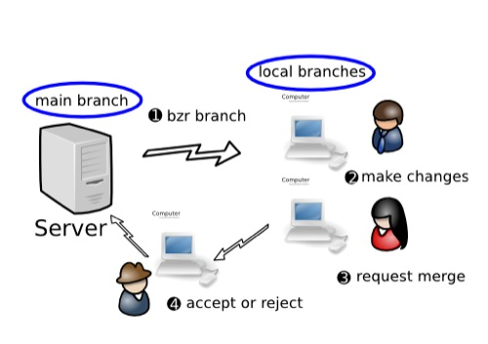
Version Control Systems
CVS
first release in 1986
Subversion
widest adoption
many open-source projects use Subversion as a repository (Apache, Python, Ruby,…)
Git
Used by the Linux kernel, wine, Fedora, …
Mercurial
open-source distributed version control
can be used for small and large projects
Bazaar
user friendly, good setup flexibility
used by Ubuntu, MySQL, Squid, …

Slide 6
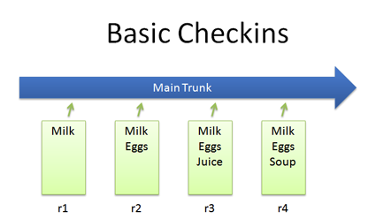
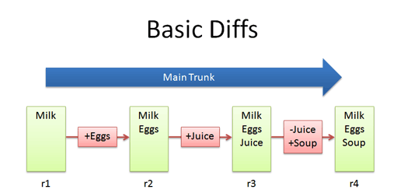
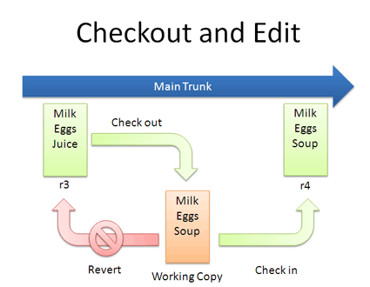
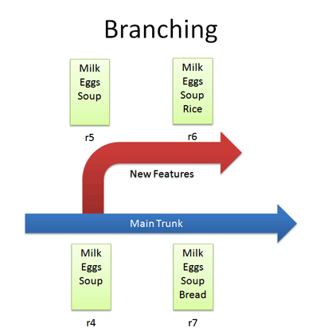
Subversion

Slide 7
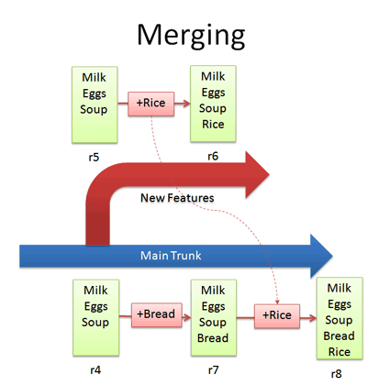
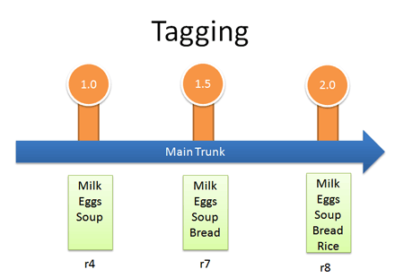
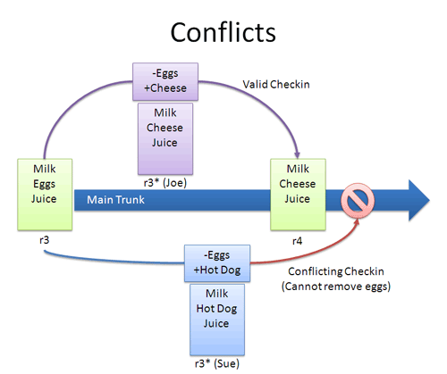
Subversion

Slide 8
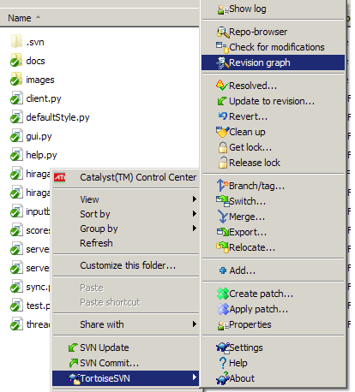
Subversion
SVN checkout
Downloads repository contents to a local folder
Update
Merges new changes from repository to the local working copy. Updates before every commit are important .
Commit
Merges changes from local copy to SVN repository.
Resolved
Tells SVN that the conflicted file is now OK.
Add
Schedules new file to be saved to repository with next commit.
Delete
Schedules file to be deleted from repository with next commit. Accidental deletes can be recovered.
Revert
Undoes all changes to the local copy since last commit. Throw away the changes and start over.
Log
Shows log of changes sorted by date

